Slide 1

Build the Block
Notes:
Welcome to Build the Block! Thanks for being here today eager to learn about what impacts design decisions when you’re creating a new school, hospital, or housing complex.
My name is _____, and I’m an architect. I will be leading us through this game today, which demonstrates the impact that architects and the field of architecture can make on communities—even yours—through real world design principles.
Before we begin, here’s a quick overview of the game…

Slide 2
Scenario
There’s an empty lot in your community. Decide what to build on this lot—a school, hospital, or affordable housing units.
Goal
Fulfill all the needs in your community.
Materials
Each player needs some paper and a pencil.
Notes:
The premise of the game is that there is an empty, overgrown lot in a fictitious town. As a team, we must identify the best use of the lot and decide how to develop the site with the ultimate goal of fulfilling the needs of our community.
There is a sketching portion of the game, and for this you will need to have some paper and a pencil handy. You can also grab some markers, crayons, or colored pencils if you’d like to add some color to your sketch, but this is not mandatory.

Slide 3
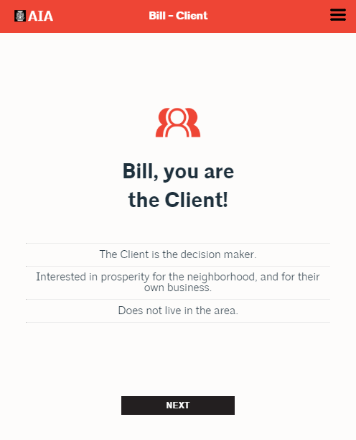
Your role
You play this role the entire game
Write down your role and characteristics
The Client
The Client makes the final decision on what to build
Notes:
Each of you will be assigned a role in the game. Each role has three characteristics. It’s your job to remember your role and characteristics – so I recommend that you write them down. It’s up to you to advocate for your role’s opinions and priorities throughout the game. There is a lot of discussion in this game. Don’t be shy! Use your voice.
When it comes to making decisions, the person playing the Client has final say and can make any selection he or she wants, regardless of the group’s discussion. It’s your job to persuade the Client to make the decision YOU want!

Slide 4
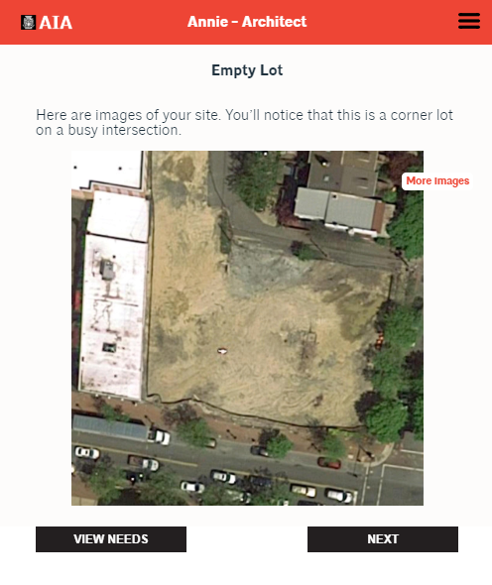
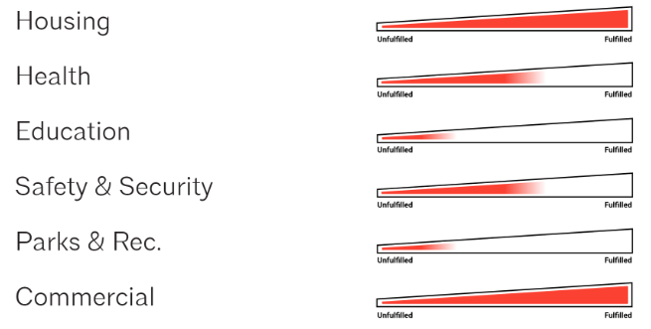
Your community and your lot
As a group, we create our community
Then we’ll learn about and see our empty lot
This lot is where we’ll build our project
Then, we discuss our community’s needs.
Notes:
Once everyone has their roles, we get to create the community in which our lot is located. We can be as creative and detailed as we want!
Then, we will see a couple images of our lot, where we will build our project.
At this point, we will also see our community’s needs. We’ll be measuring six factors – housing, health, education, safety, parks & rec, and commercial – and our goal is to fulfill as many community needs with our building as possible.

Slide 5
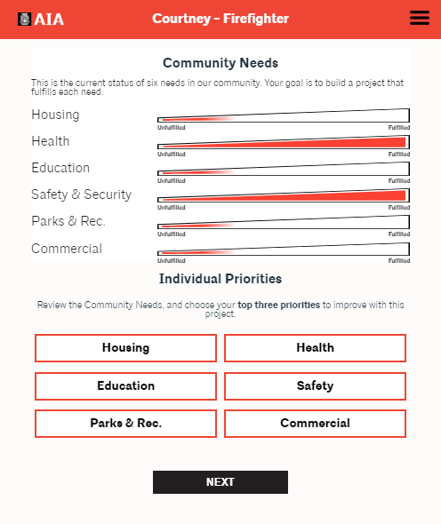
Tip: The role displayed at the top of the screen is who should be voting.
Vote for your Individual Priorities
Once we’ve discussed the community’s needs as a group, you will vote for your top three priorities, keeping your role’s characteristics in mind.
Notes:
After we’ve discussed our community’s needs, each of you get to vote for YOUR priorities. Remember, you’re each playing a role! You get to vote for your individual priorities, regardless of the community’s needs.
Each person will have a turn to vote. We’ll keep an eye on the top red bar to make sure you’re voting when your name appears!
After everyone has voted, we’ll see a tally of the results.

Slide 6
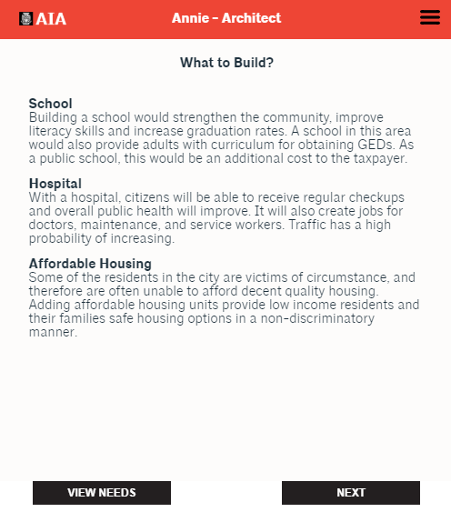
Deciding what to build
Discuss the building options as a group.
Voice your opinion on which building you should choose—remember your role’s characteristics and priorities.
Convince the Client to choose your building.
The Client makes the final decision.
Notes:
Then, we finally get to decide what to build! We can choose from three options: a school, hospital, or affordable housing.
This is your last chance to convince the Client to choose what YOU want to build, so use your voice. Then, the Client will make the final decision.
Once we make our selection, we’ll also be able to add a few enhancements to our project.

Slide 7
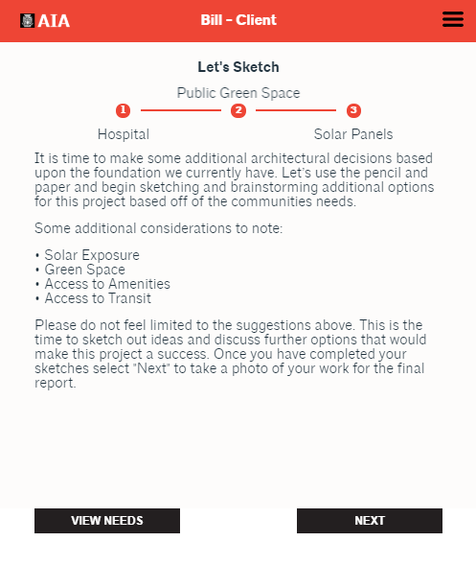
Sketch your building
Once all our decisions have been made, we’ll each get to sketch our building.
Use paper and pencil for your sketch. You can be creative with color, too!
We will each present our sketching to
the group.
Notes:
Once all our decisions have been made, we each get to sketch our building! As I mentioned earlier, each of you should have some paper and pencil handy for this part of the game.
We’ll all take some time to sketch independently and then present our sketches to each other. Don’t worry – it doesn’t have to be perfect!

Slide 8
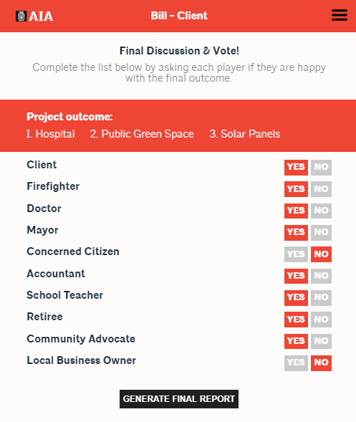
Final discussion
Discuss if you’re happy with the result and cast your vote.
Review our decisions and determine if our building has improved our community’s needs.
Notes:
Finally, everyone in the group gets to vote on the final outcome of the project. Did you like your selections? Are you happy with the sketches? Why or why not? I’ll record your answers in the game.
Then, we can talk about our decisions and determine if we improved the needs of our community.
Any questions?

