Slide 1
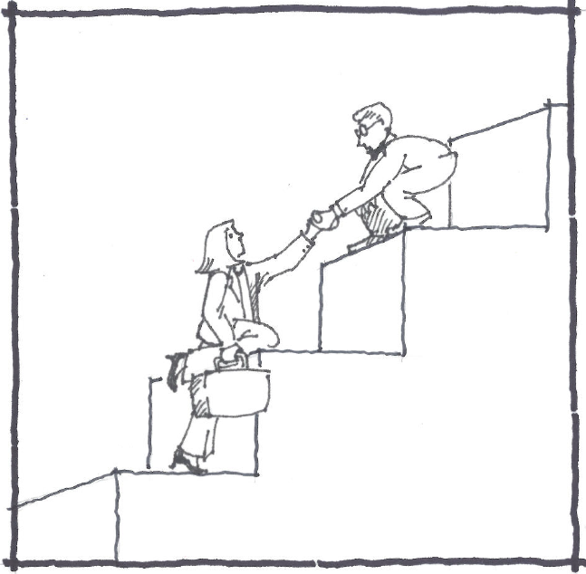
Designing Your Best Mentoring Experience Ever!
Contributors:
Anna Barbour,AIA
Damian seitz,aia
Maggie SCHUBERT,aia
Ben mccreary,aia
Teera games,aia
Panelists:
Jim Richardson, AIA
brian frickie, aia
Kathryn prigmore, faia
Wil scribner, faia
November 3, 2011

Slide 2
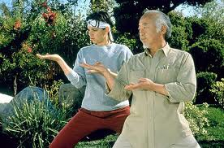
What is Mentoring?

Slide 3
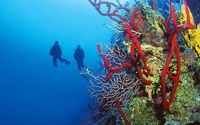
What is Mentoring?
Knowledge
Wisdom

Slide 4
Career Stages
STUDENTS: AIA Atlanta, U of Minn Mentor Idea: Intern or Practicioner
INTERNS: IDP, AIA Boston, Your firm Mentor Idea: YAF
YAF: YAF G/L Mentor Idea: AIA or FAIA
PRACTICIONERS
Student
Intern
Young Professional
Practicioner
Notes:
The format for mentoring may differ as you pass through the various stages of your career. For students, the mentoring programs tend to be more structured typically consisting of a one-year relationship. The University of Minnesota has an excellent website with resources for students and praticioners to help guide them through the process. AIA Atlanta also has a program which pairs students with pracitioners.
For interns, the IDP program provides specific guidance and requires that you have a mentor, suggesting that this person should be outside your firm. AIA Boston has an active program and many firms in Virginia provide a support network to help interns find mentors outside the firm. Our findings have shown that one of the best mentors for interns may a young professional because they just recently passed the exam.
The Young Architects forum has strongly supported the idea of mentoring and frequently highlights best practices in its publications. Here in Virginia we are recruiting AIA Fellows to work with YAF members and so far have XX Fellows signed up.
So what about practicioners? Don’t we need a mentor too? The concept of “Laddered mentoring” means serving as a mentor to someone while receiving mentorship from another. Some AIA Chapters are arranging teams of architects at various stages in their career so that this can take place.

Slide 5
Best Practices - Roles
Protege
Mentor
Motivated, Interested, Engaged, Curious
Respect boundaries
Be patient…we’re old
Be receptive to feedback
Say what you want
Tour Guide not Teacher
Explain the “why”
Meet on protégé’s turf
Be available
Don’t problem-solve

Slide 6
Best Practices -Mentoring “Musts”
 | IDP | U Minn | Zachary | YAF
Communication
Commitment/Desire
Trust/Confidentiality
Reflection/Awareness

Slide 7
Best Practices- Architects
Personality
Self Image
Most architects: NTJs
Lifelong learners
Rational
Can seem distant
Can be introverts
Problem solvers
Perceive time in intervals
Ingenious
Resolute
Autonomous

Slide 8
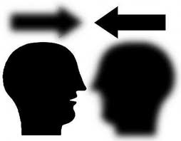
Communication
Distant-
Introvert-
Autonomous-
Perceive time in intervals-
Also…..
Generational differences
Listening
Guiding not teaching

Slide 9
Trust/Confidentiality
Notes:
One of the reason that the iDP program recommends that your mentor be somebody outside your firm is to allow mentor and protégé to freely discuss issues and problems that may be related to the work environment. This is an advantage if find yourself needing advice in how to cope with a tricky political situation at the office, or trying to identify your next career step without necessarily alerting the office to your plans. The bond of trust is built over time and can provide the “Oasis” from what may seem like at a world of relentless demands. In fact, I’d encourage you to think about a mentoring relationship with this image.

Slide 10
Committment
What is the biggest challenge for a successful mentoring relationship?
TIME
Notes:
Without exception, when surveyed, mentors and proteges alike said one of the biggest challenges was finding the TIME to meet and time to prepare for meetings. We are all busy, so your ability to find the time to participate is a reflection of your level of commitment. For those who did make the time, overwhelmingly the results were positive. They all said “It was well worth the time”.
Distractions…….attention…..bandwidth Make it an OASIS
Here are some tips for finding time to engage in a mentoring relationship. Identify the “time eaters” that provide no value or benefit and reduce or eliminate them. >>>>more<<<<<

Slide 11
Reflection

Slide 12
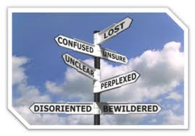
Where to Start?

Slide 13
Best Practices
Preparing
Closing
Negotiating
Enabling
Preparing + Assess readiness + Identify skills, strengths + Clarify expectations + Assess viability | Negotiating + Timeline + Learning Goals + When/How to meet + Boundaries /Limits + Rocks in the road | Enabling + Giving & receiving feedback + Sharing wisdom & knowledge | Closing + Celebrate achievements + Reflect on learning + Pay it forward

Slide 14
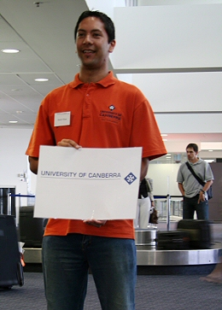
Best Practices- Matching
Ideas:
Speed mentoring events
Other AIA Chapter Social events
Speed portfolio reviews
Web-Yentl
Rotary Club
Mentor

Slide 15
Best Practices - Formats
One-on One
In Person
Long distance
Small Mentor Clusters
San Francisco model
Laddered Mentoring
Emerging Leaders Programs
Small Mentor Clusters: San Francisco Model:
+ One Seasoned, licensed professional (+/- 15 years of experience) + Two Mid-level, licensed or unlicensed professional (5-15 years of experience) + One Emerging, unlicensed professional (0-5 years of experience)

Slide 16
Discussion

